Slide 1

AI and Machine Learning for IoT Big Data

Slide 2
AI for prediction

Slide 3
Outline of the lecture
After collecting field data, we might want to predict what would happen in cases that were not among the data points.
We will learn some common and simple methods that create a predictor from a set of training data. That predictor then can be fed a new data point and its output will provide an estimate of what would be observed in that case.

Slide 4
Where are we in the Course?
Introduction: Background of IoT, Big Data, AI
Collect, analyze data from IoT on a large scale
Elements and practice of statistics
AI methods for data science
Getting further with AI: internal workings
Practical usage of AI for Big Data from IoT
Moving into the real world

Slide 5
Lecture 5: Prediction with AI
Learning from samples
Supervised learning algorithms
Multi-layer neural networks
Support Vector Machines
Deep Learning for prediction

Slide 6
Learning vs. memorization
Imagine showing the computer a picture of a cat, saying “A cat”. Computer says: “OK”
Show another cat; computer: “OK”
Show a dog, saying “A dog”; computer: “OK”
Show the first cat again, asking “What is this?”; computer says “A cat.”
Now show a third cat; computer says “No idea”. Is this what we want?
Notes:
Expand: if we are just matching pictures pixel to pixel, then the first cat photo, but with one pixel blacked out, would also get “No idea”.
We want the computer to recognize something common to cats, as opposed to common to dogs.
Some more hidden assumptions: we can expect to recognize only common traits that are evident from photos.
We expect learning “cats” vs. “dogs”, maybe “old cats” vs. “young cats” etc.
But for instance, can we expect to learn “Cats owned by women” vs. “Cats owned by men”?
Or, “German cats” vs. “Belgian cats”?
Can you start describing how you discriminate between cats and dogs?

Slide 7
What is “learning”?
In the context of prediction, learning is the creation of a function for estimating an unknown variable
The function should minimize the expectation of the error of estimation
The function should use available observations and possibly a-priori knowledge about the domain
Notes:
“Function” here is a mapping from the inputs to outputs; it can be a computational process, not just a straightforward mathematical function.

Slide 8
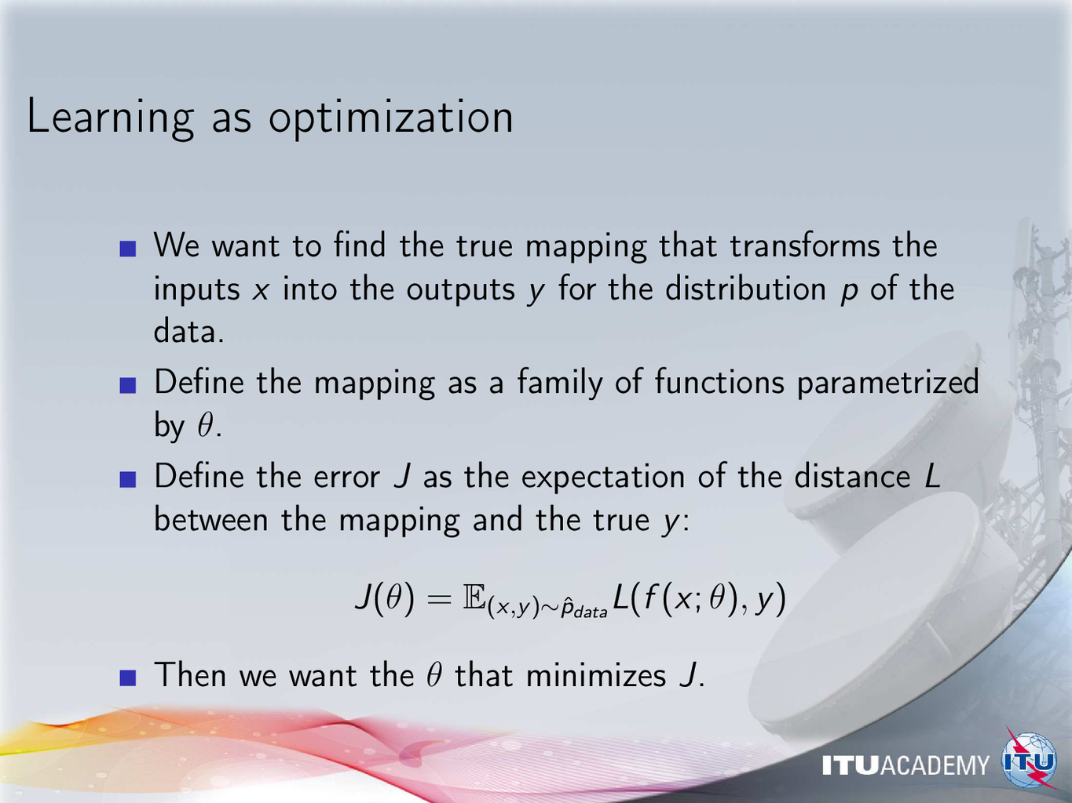
Notes:
The data distribution is actually the process that generates the data, we assume that it is stationary.
Point out that the observed distribution of the samples is not the same like the underlying (hidden) distribution.

Slide 9
Learning vs. optimization
The true distribution p of the data is unknown, we can only infer it from sample pairs of (x,y)
Thus the best we can do is finding a mapping that fits the samples, hoping that it will fit also other, unknown samples
Choosing a “good one” between the infinite number of possible mappings is the art of machine learning
Notes:
Important: a properly defined data distribution p would still require effort to generate an explicit mapping function, but in principle we would not need to introduce tricks with regularization, validation etc. These things come from the need to infer the hidden distribution, and are techniques for adding an implicit model of how we expect p to behave.

Slide 10
What functions to use?
Traditional regression: use a linear estimate mapping observed inputs to observed outputs
“Learning” for regression: least mean squares
Neural networks: use nonlinear functions with biologically inspired structures
“Learning” for neural networks: many heuristic procedures
Notes:
Review the linear regression process from the FM7 module

Slide 11
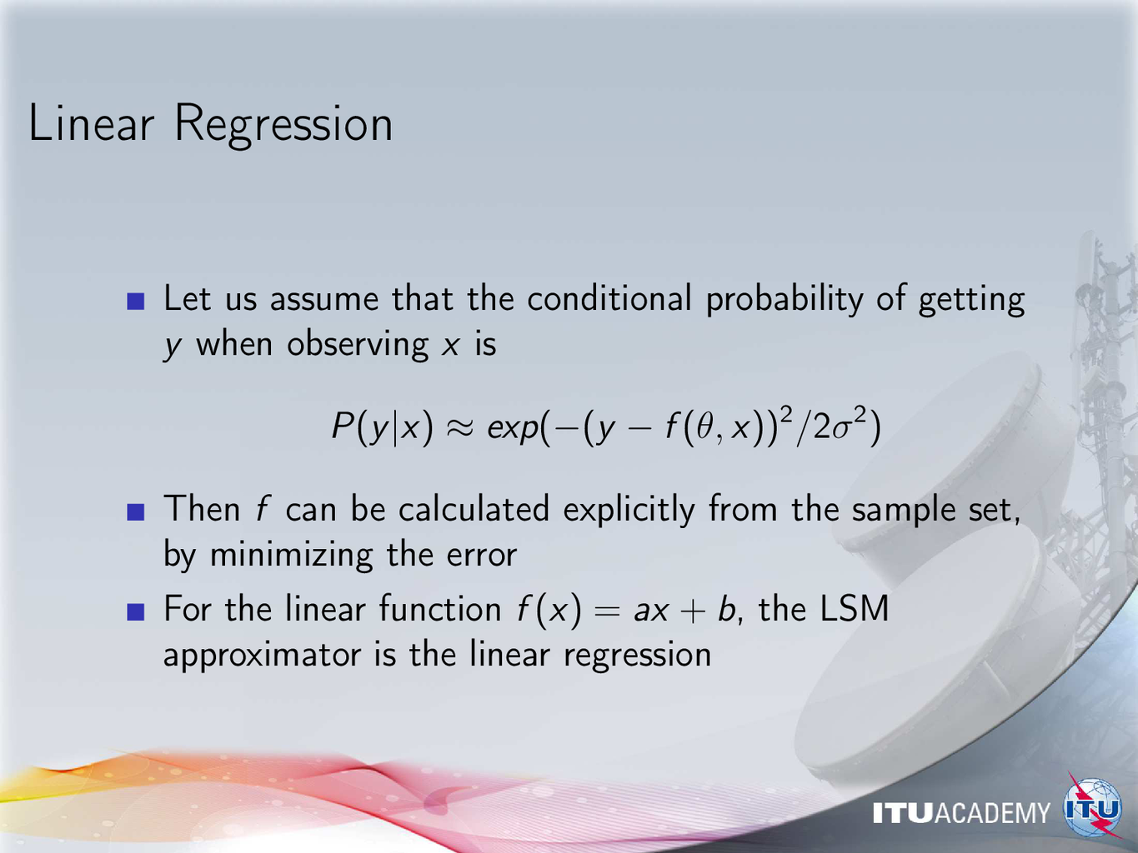
Notes:
These slides are just reminders!

Slide 12
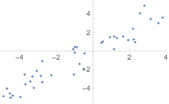
Example: noisy distribution and linear fitting
Wolfram Research, Inc., Mathematica, Version 11.3, Champaign, IL (2018).

Slide 13
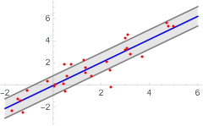
Prediction and confidence interval
Wolfram Research, Inc., Mathematica, Version 11.3, Champaign, IL (2018).

Slide 14
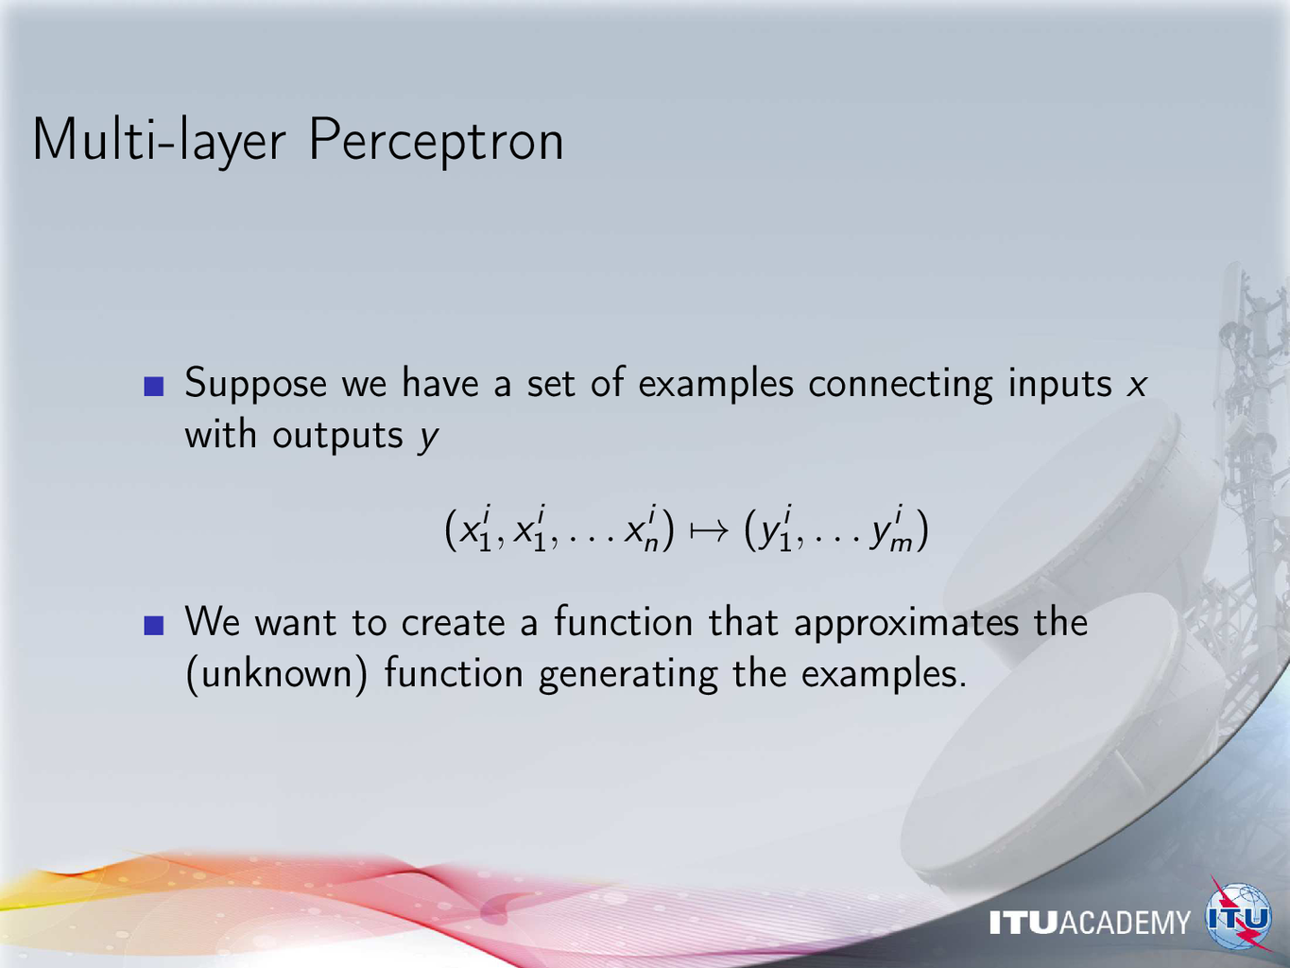
Notes:
Here the index “i” goes through the data samples.

Slide 15
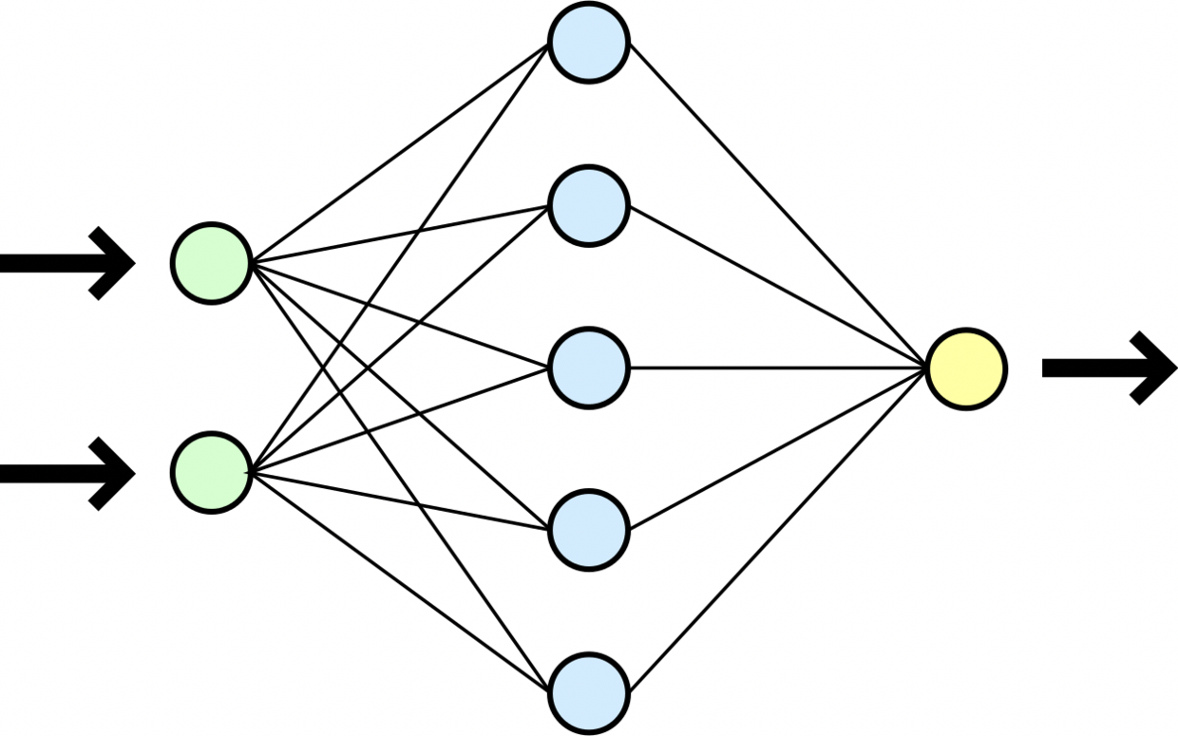

One choice: the Multi-Layer Perceptron
By Dirk Hünniger (Own work) [CC BY 3.0 (http://creativecommons.org/licenses/by/3.0)], via Wikimedia Commons
Example with 2 inputs, 1 output, 1 hidden layer
The lines indicate “connections” or “synapses”
The circles are the “neurons”, performing a computation shown in the next slide
Notes:
Example: XOR
0,0 -> 0
0,1 -> 1
1,0 -> 1
1,1 -> 0
Recall: this cannot be realized with a perceptron without a hidden layer

Slide 16
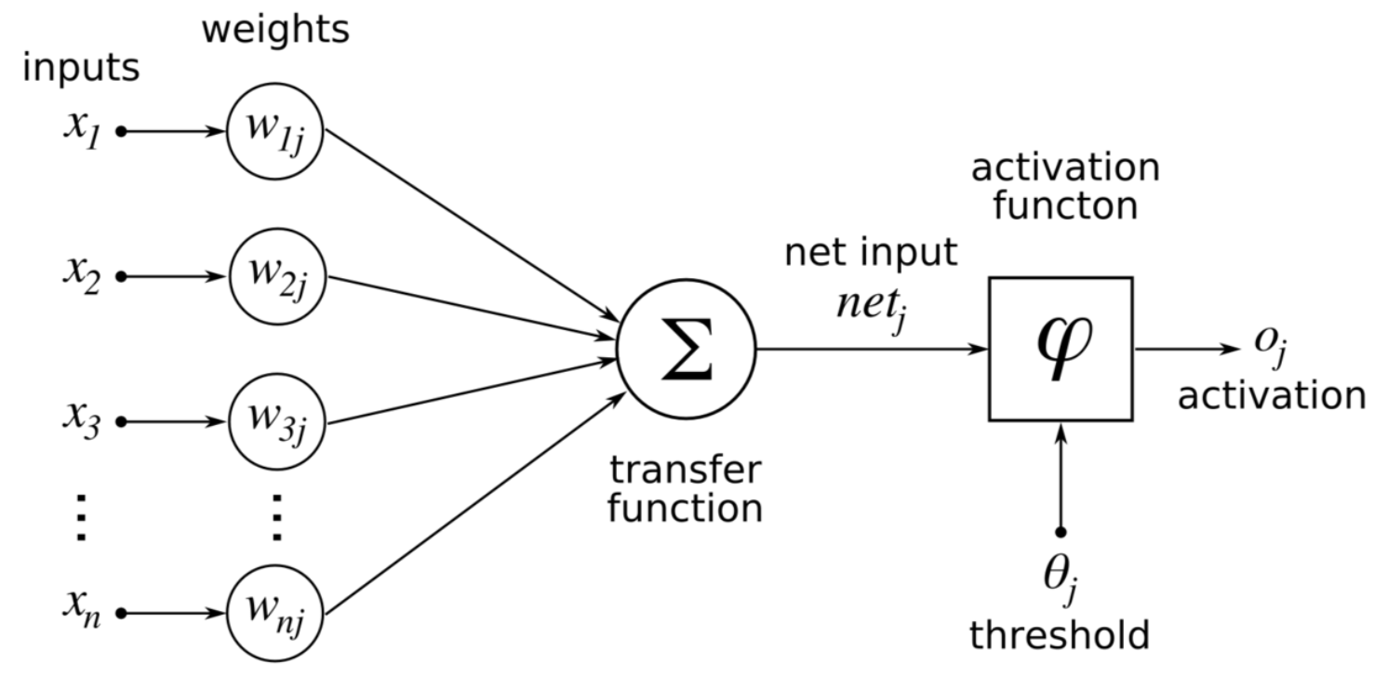
Signal propagation through one neuron
Calculate the weighted sum of the input signals.
Then pass it through the (usually nonlinear) activation function.
The resulting “activation” will be the output, or fed to the next neuron layer.
Artificial Neural Networks, wikibooks.org, 2013
Notes:
What are the weights, threshold, activation? Discuss possible choices; is a linear activation useful? When?

Slide 17
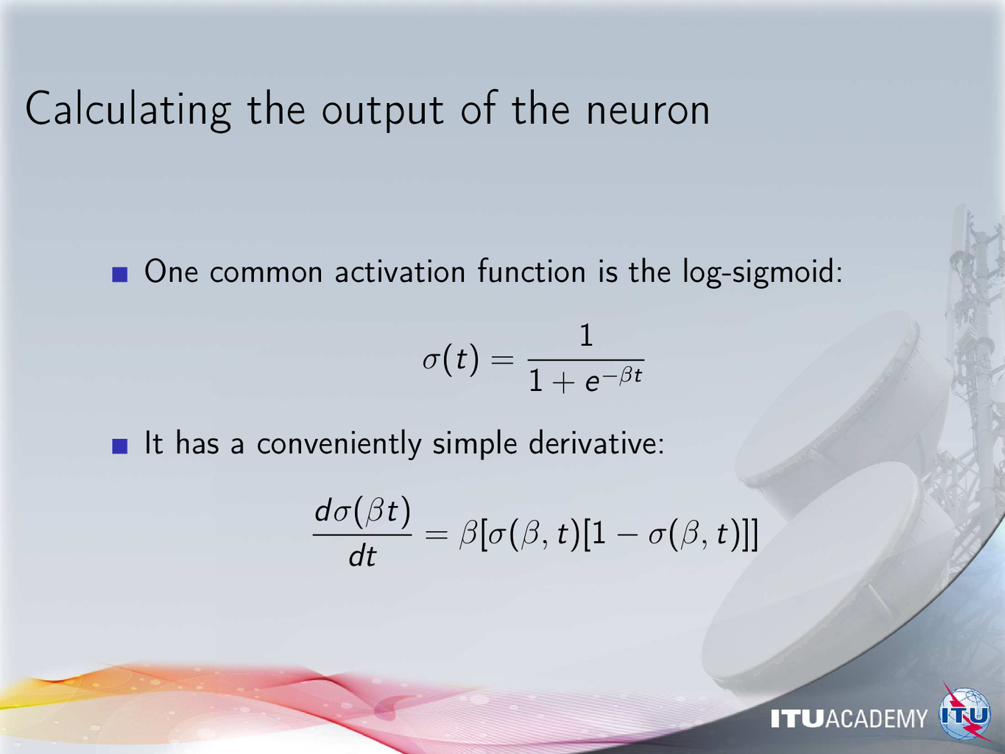
Notes:
Why is the derivative important?

Slide 18
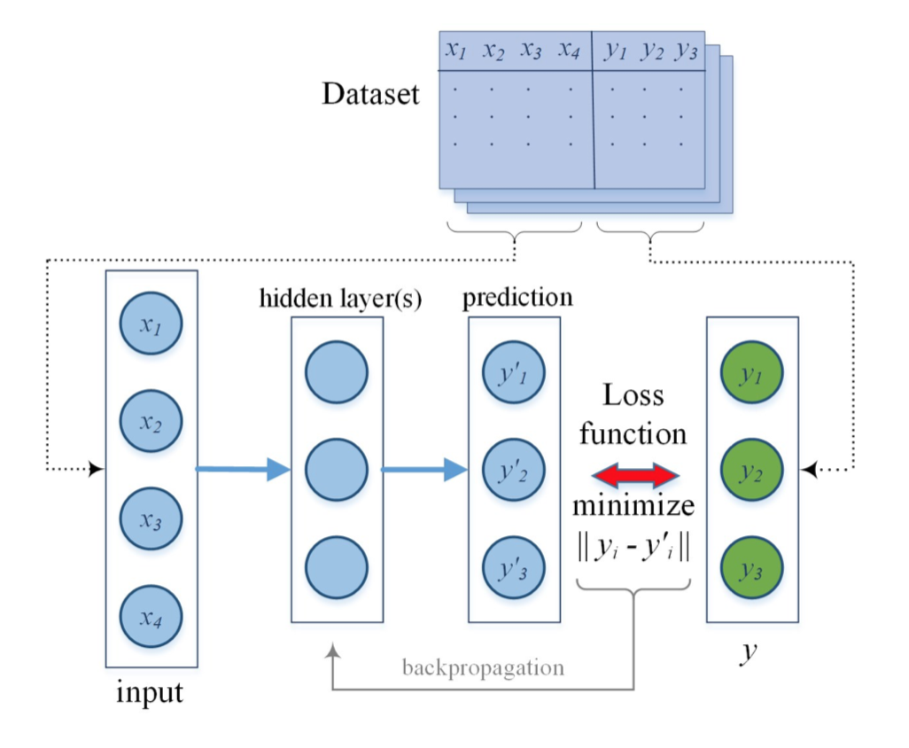
Basic principle of learning for neural networks
Modify the connection weights so as to reduce the loss
Deep Learning for IoT Big Data and Streaming Analytics: A Survey
Mehdi Mohammadi, Graduate Student Member, IEEE, Ala Al-Fuqaha, Senior Member, IEEE,
Sameh Sorour, Senior Member, IEEE, Mohsen Guizani, Fellow, IEEE
https://arxiv.org/pdf/1712.04301.pdf
Notes:
Feedforward signal propagation is just one possible architecture, but currently it is the most popular.

Slide 19
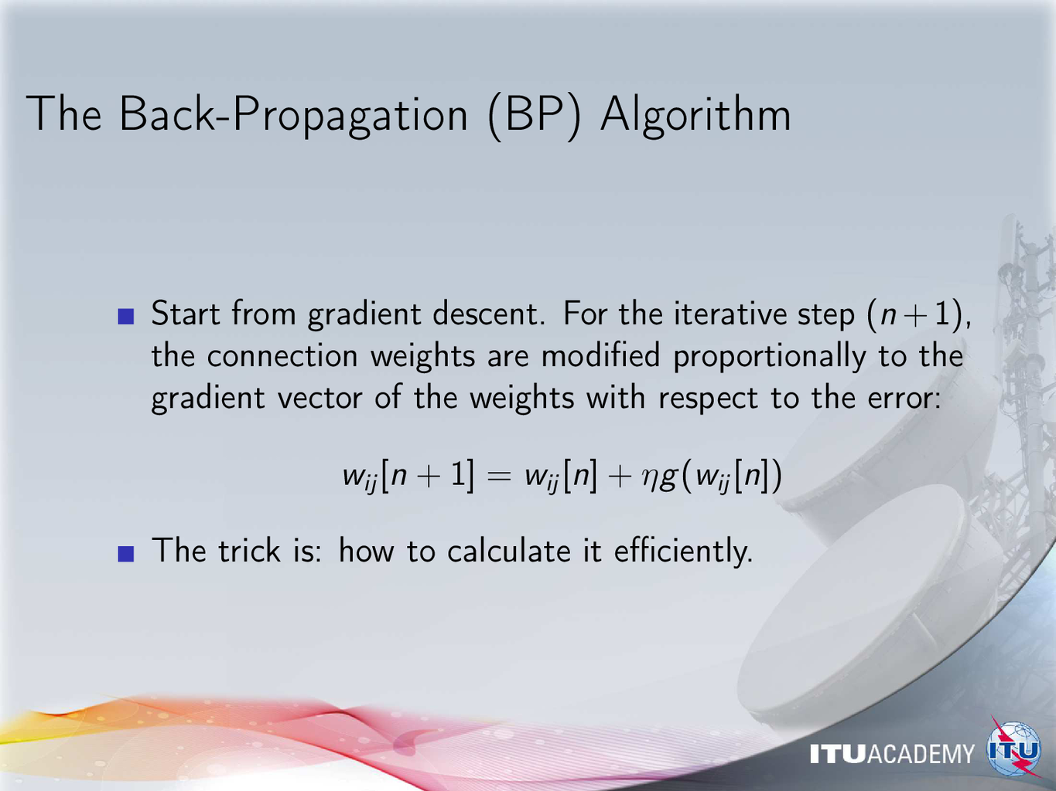
Notes:
It is possible in principle to treat the whole neural network as a unit, and calculate the gradient vector of the weight matrix;
but probably nobody does that.

Slide 20
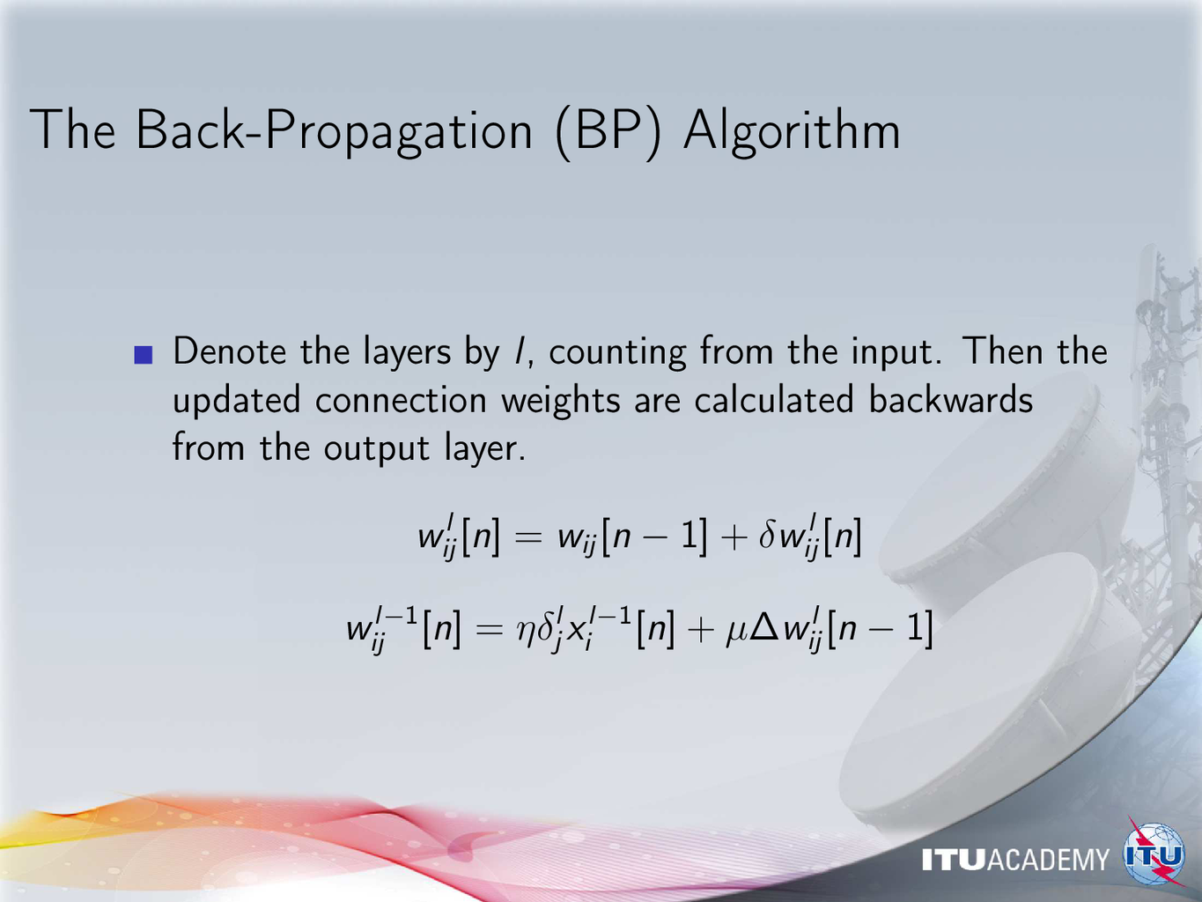
Notes:
Explain:
First we calculate the output layer weight gradients w.r.t. the error (either single sample or batch).
Then we calculate the gradients in the preceding layer, using the weight differences in the output layer.
This way, we work backwards to the input layer.
Intuitively:
The update of the output layer tries to reduce the output error.
“If the weights here were w+dw instead of w, the error would have been less”
The update of the preceding layer tries to reduce the change required in the next layer.
“If the weights here were w+dw, the input to the next layer would have been such that less change would have been needed to reduce the error”

Slide 21
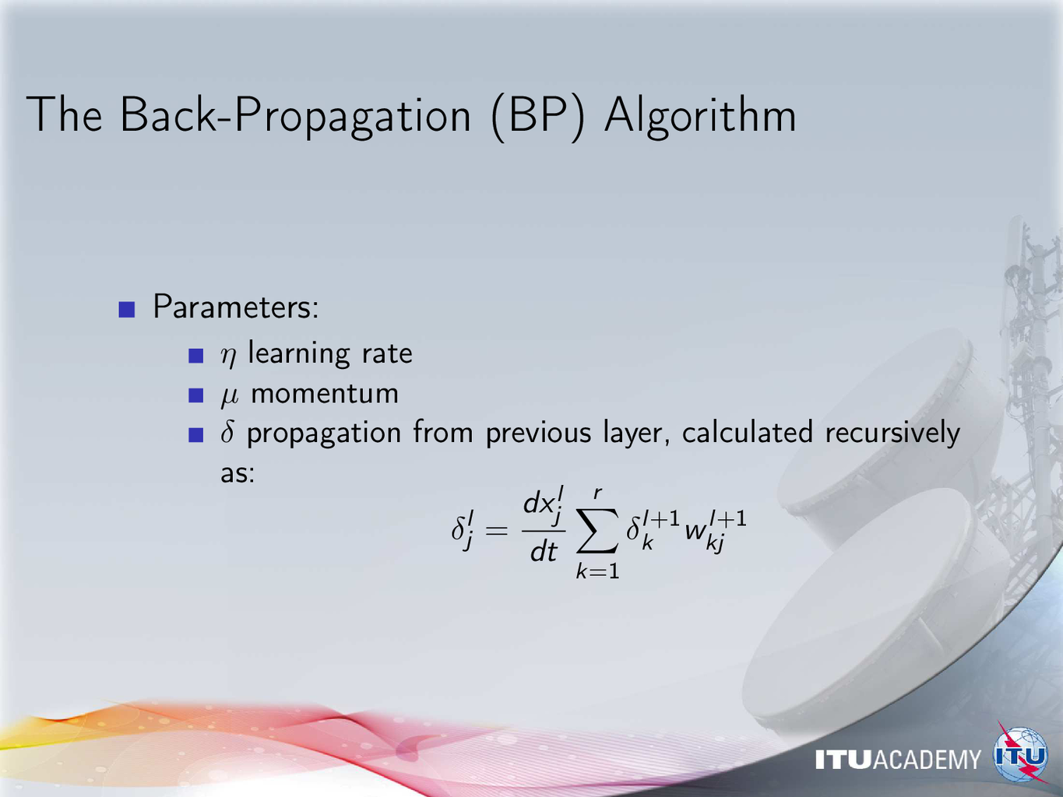
Notes:
There are many proposals to set or adjust these meta-parameters heuristically,
or to estimate their optimal values from the network values and the data.
Another useful acceleration technique is using line search with each gradient direction.

Slide 22
Applications of MLP with BP
Very efficient for learning with relatively low-dimensional inputs
High dimensional data, like image, sound, video, should be pre-processed into low-dimensional feature vectors
Over-fitting can occur with high internal degrees of freedom
Notes:
Recall BP from FM7

Slide 23
Support Vector Machine (SVM)
Support vector machines are binary classifiers, using the maximum-margin hyperplane that separates classes, modeling class probabilities.
The maximum-margin hyperplane is found from training data
For linearly separable cases, the hyperplane is found in the space spanned by the input vectors
Notes:
Recall SVM from FM7

Slide 24
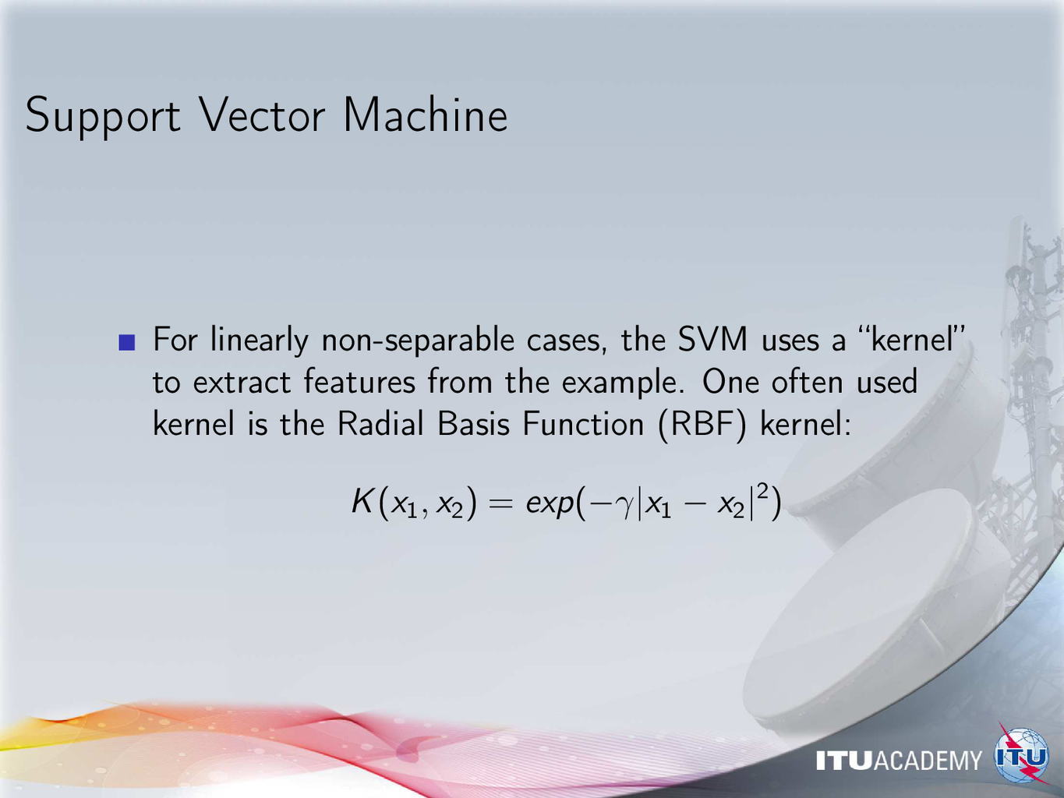
Notes:
How does a “Kernel” enable us to create a non-linear separation boundary?
Consider the possibilities before looking at the cylindrical example.

Slide 25
Support Vector Machine
https://commons.wikimedia.org/wiki/File:Svm_10_perceptron.JPG
Finding the separating hyperplane between classes
even when there is no linear separation

Slide 26
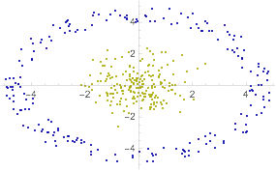
Two classes to be learnt by a SVM classifier
Wolfram Research, Inc., Mathematica, Version 11.3, Champaign, IL (2018).

Slide 27
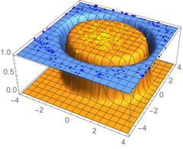
An SVM with a Radial Basis Function kernel
Wolfram Research, Inc., Mathematica, Version 11.3, Champaign, IL (2018).
Notes:
Possible assignment: re-create this with Keras

Slide 28
Summary of the lecture
We have reviewed some of the most common methods for learning from samples: linear regression, multi-layer perceptrons, and Support Vector Machines.
The methods of this lecture can be used to deal with predicting new cases from a set of collected observations.
This lecture is a preparation before continuing with Deep Learning for similar tasks.

